Slide 1



Department «Electrical engineering and heat power engineering»
Emperor Alexander I St. Petersburg State Transport University
The Faculty of Transport Systems and Power Engineering

Slide 2
Department “Electrical engineering and heat power engineering”
DIRECTION OF TRAINING
Our Department recruits school leavers and graduates and trains students due to the following programs:
Bachelor’s Degree Program
13.03.01 " Heat power engineering and heat engineering»,
profile " Industrial heat power engineering»
Master’s Degree Program
13.04.02 " Electric power and electrical engineering»
Master's program " Modern technologies, management, audit and analytics in industrial power engineering»

Slide 3
50 Department members, including 6 full professors (doctors of engineering), 17 associate professors (candidates of science), 7 senior lectures and 3 assistants carry out the educational process
Department “Electrical engineering and heat power engineering”

Slide 4
Department “Electrical engineering and heat power engineering”
Bachelor’s Degree Program
We train highly-qualified specialists in the field of industrial heat power engineering. Students study the following fundamental disciplines for their future profession:
Sources and systems of heat supply;
Boiler plants and steam generators;
Heating, ventilation and air conditioning;
Alternative energy sources;
Superchargers and heat engines;
Fuel and lubricants;
Protection of the atmosphere against harmful emissions of power plants.

Slide 5
Department “Electrical engineering and heat power engineering”
Master’s Degree Program
The Master's degree program "Modern technologies, management, audit and analytics in industrial energy" lets to expand the boundaries of student knowledge and to prepare a solid basis to enter the postgraduate study.
Students study the following fundamental disciplines for their future profession:
Use of alternative energy sources.
Computer network and information technologies.
Basis of preparation of the thesis.
Management in industrial heat power engineering.
Problems of energy saving and resource saving.
Modern technologies of fuel preparation and fuel burning.
Natural gas liquefaction technologies.
Energy audit of industrial enterprises.

Slide 6
Department “Electrical engineering and heat power engineering”
POSTGRADUATE STUDY
We constantly work to improve the qualification of the staff members and the students wishing to get a degree of candidate of technical sciences.
Due to the complexity of our direction, the term of the postgraduate study is 4 years.

Slide 7
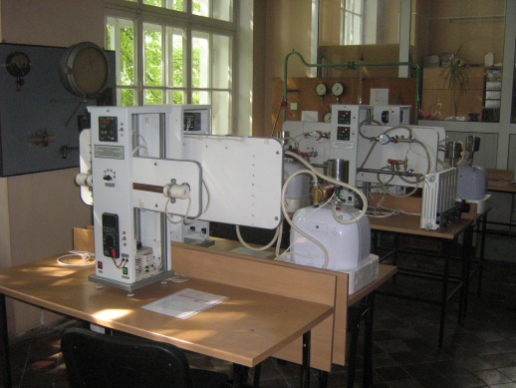
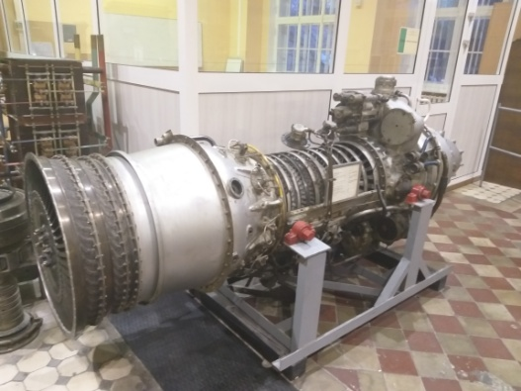
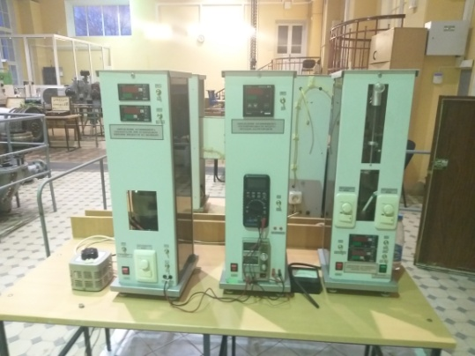
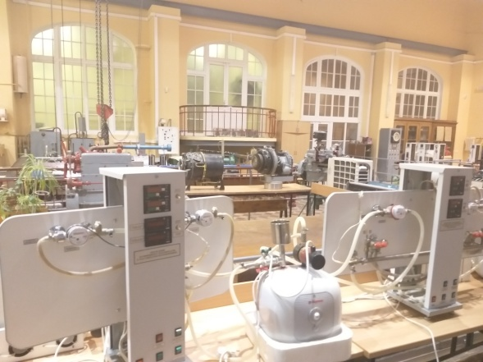

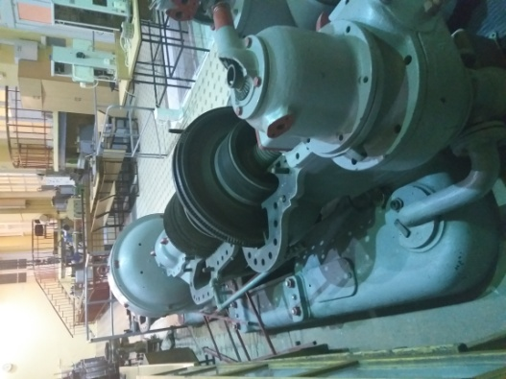
Department “Electrical engineering and heat power engineering”
MATERIAL – TECHNICAL BASE
The Department has its own computer class, lecture halls equipped with modern technical training facilities, 17 educational laboratories with modern equipment and research laboratory.

Slide 8

Department “Electrical engineering and heat power engineering”
EMPLOYMENT
Graduates of the Department are in demand by leading design and scientific
the organizations of an energy profile as the main power engineers and chiefs of thermal power floors at plants and factories, on thermal power plants, in modern gas boilers and on heat network sections in structures of Open Society "Russian Railways", Open Society "Gazprom", GUP TEK SPb, Danfoss and other companies.
The University holds meetings
of future graduates with employer's representatives
regularly.
Also «JOB FAIR" is regularly held.

Slide 9
Department “Electrical engineering and heat power engineering ”
HEAT POWER ENGINEERING IS
HIGH WAGES AND INTERESTING WORK!
We will make you highly qualified specialists
demanded in
Open Society "Russian Railways ", Open Society "Gazprom", utilities sector,
and many other industries !
You will take part in the implementation of state programs on the development of energy and energy saving!
Heat power engineers are required everywhere -
from the supermarket to the spaceport!

Slide 10
CONTACT INFORMATION
Address:
Russia
190031, Saint Petersburg, 9 Moskovsky pr., 6 building Emperor Alexander I St.Petersburg State Transport University корпус (PGUPS),
Rooms 6-204, 6-205
The Faculty of Transport Systems and Power Engineering
DEPARTMENT “ELECTRICAL ENGINEERING AND HEAT POWER ENGINEERING”
Phone: (812) 457-85-37; (812) 457-81-42
E-mail: toe@pgups.ru
https://www.pgups.ru/en/struct/kafedra-elektrotekhnika-i-teploenergetika/

